Slide 1
Outcome Attainment Mechanism
Mr. Muhammed Faisal
Assistant Professor, Department of Commerce

Slide 2
Key Indicator 2
Teaching- Learning and Evaluation | 2.1 | Student Enrolment and Profile | 40
 | 2.2 | Catering to Student Diversity | 50
 | 2.3 | Teaching-Learning Process | 50
 | 2.4 | Teacher Profile and Quality | 60
 | 2.5 | Evaluation Process and Reforms | 30
 | 2.6 | Student Performance and Learning Outcomes | 60
 | 2.7 | Student satisfaction Survey | 60
 |  |  | 350 | 4 | 1400

Slide 3
Key Indicator 2 |  |  | Key Aspects | Weightage
Student Performance and Learning Outcomes | PLAN | 2.6.1 | Teachers and students are aware of the stated Programme and course outcomes of the Programmes offered by the institution. | 15
 |  | 2.6.2 | Attainment of Programme outcomes and course outcomes are evaluated by the institution. | 15
 | Academic Schedule & Plan/ Teaching- Learning System / Evaluation
 | OUTPUT | 2.6.3 | Average pass percentage of Students during last five years | 30

Slide 4
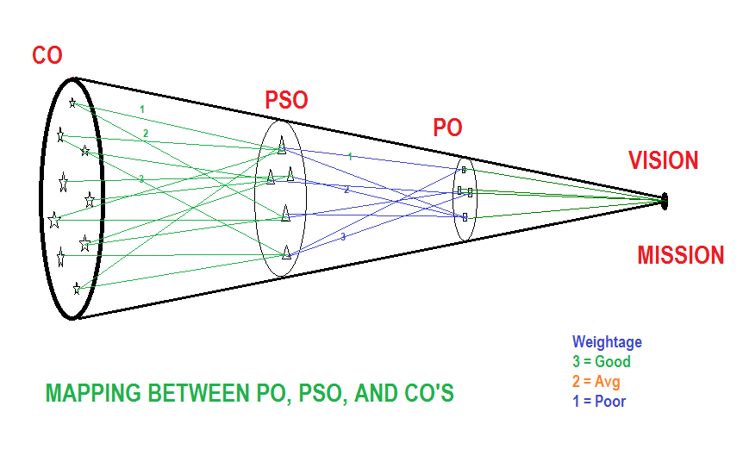

Slide 5
Course Outcome Evaluation
Based on Nature of the Courses
Internal Exam
Test Paper
Group Discussion
Assignment
Seminar
Viva Voice
Project & Practical's
Industrial Visit
Feld Visit
Study Tour
Performance in Curriculum Extension
Other Extension

Slide 6
COURSE CODE |  | CO1 | CO2 | CO3 | CO4
PARTICULARS |  | Total Marks in CO 1 | Total Marks in CO2 | Total Marks in CO 3 | Total Marks in CO 4
Reg Number | Name of Students | 5 | 5 | 5 | 5
0 | XX | 4 | 3 | 1 | 1
0 | XX | 3 | 2 | 5 | 5
0 | XX | 2 | 1 | 5 | 5
0 | XX | 1 | 5 | 4 | 4
0 | XX | 5 | 5 | 3 | 3
0 | XX | 5 | 4 | 0 | 0
0 | XX | 4 | 3 | 4 | 4
0 | XX | 3 | 0 | 0 | 0
0 | XX | 0 | 4 | 0 | 0
0 | XX | 4 | 0 | 0 | 0
Average Marks |  | 3.1 | 2.7 | 2.2 | 2.2
Percentage |  | 62 | 54 | 44 | 44

Slide 7
COURE OUCOME ATTAINMENT
Course Outcome Code | Course Outcome | In %
CO1 | Type here the descriptive course outcome | 62
CO2 | Type here the descriptive course outcome | 54
CO3 | Type here the descriptive course outcome | 44
CO4 | Type here the descriptive course outcome | 44

Slide 8
CO attainment | In % |  | Weightage Index
CO1 | 52 |  | No correlation | Poor | Average | Good
CO2 | 26 |  | 0 | 1 | 2 | 3
CO3 | 36
CO4 | 10
CO5 | 28

Slide 9
CO - PSO MATRIX
Course Code | PSO 1 |  | PSO 2 |  | PSO 3 |  | PSO 4 |  | PSO 5
 | weightage |  | weightage |  | weightage |  | weightage |  | weightage
CO1 | 3 | 156 | 2 | 104 | 1 | 52 | 1 | 52 | 1 | 52
CO2 | 2 | 52 | 1 | 26 | 3 | 78 |  | 0 |  | 0
CO3 | 1 | 36 | 2 | 72 | 2 | 72 |  | 0 |  | 0
CO4 | 2 | 20 | 0 | 0 | 3 | 30 |  | 0 |  | 0
CO5 | 3 | 84 | 2 | 56 | 1 | 28 |  | 0 |  | 0
Totals
 | 11 | 3.48 | 7 | 2.58 | 10 | 2.6 | 1 | 0.52 | 1 | 0.52

Slide 10
CO - PO MATRIX
Course Code | PO 1 |  | PO 2 |  | PO 3 |  | PO 4 |  | PO 5 |  | PO 6 |  | PO 7 |  | PO 8
 | weightage |  | weightage |  | weightage |  | weightage |  | weightage |  | weightage |  | weightage |  | weightage
CO1 | 3 | 156 | 1 | 52 | 1 | 52 | 1 | 52 | 1 | 52 | 1 | 52 | 1 | 52 | 1 | 52
CO2 |  | 0 | 1 | 26 |  | 0 |  | 0 |  | 0 |  | 0 |  | 0 |  | 0
CO3 |  | 0 |  | 0 |  | 0 |  | 0 |  | 0 |  | 0 |  | 0 |  | 0
CO4 |  | 0 |  | 0 |  | 0 |  | 0 |  | 0 |  | 0 |  | 0 |  | 0
CO5 |  | 0 |  | 0 |  | 0 |  | 0 |  | 0 |  | 0 |  | 0 |  | 0
Totals
 | 3 | 1.56 | 2 | 0.78 | 1 | 0.52 | 1 | 0.52 | 1 | 0.52 | 1 | 0.52 | 1 | 0.52 | 1 | 0.52

Slide 11
Course Outcome Attainment Chart
Course Outcome Code | Course Outcome |  |  |  |  |  |  |  |  | In %
CO1 | Type here the descriptive course outcome |  |  |  |  |  |  |  |  | 52
CO2 | Type here the descriptive course outcome |  |  |  |  |  |  |  |  | 26
CO3 | Type here the descriptive course outcome |  |  |  |  |  |  |  |  | 36
CO4 | Type here the descriptive course outcome |  |  |  |  |  |  |  |  | 10
CO5 | Type here the descriptive course outcome |  |  |  |  |  |  |  |  | 28
Program Specific Outcome Attainment Chart
 | PSO 1 | 0 | PSO 2 | 0 | PSO 3 | 0 | PSO 4 | 0 | PSO 5 | 0
PSO Weightage | 11 | 3.48 | 7 | 2.58 | 10 | 2.6 | 1 | 0.52 | 1 | 0.52
Percentage program Outome Attainemnt
 | PSO 1 | PSO 2 | PSO 3 | PSO 4 | PSO 5 | 0
 | 0.3164 | 36.857 | 26 | 52 | 52 | 0
 | 3 | 84 | 2 | 56 | 1 | 28 | 0 | 0 | 0 | 0
PO Weightage | 3 | 156 | 1 | 52 | 1 | 52 | 1 | 52 | 1 | 52

